Slide 1

Forces
Year 11
Pages 242 - 273

Slide 2
Force as a Vector
Chapter 8.1
Pages 242 - 246

Slide 3
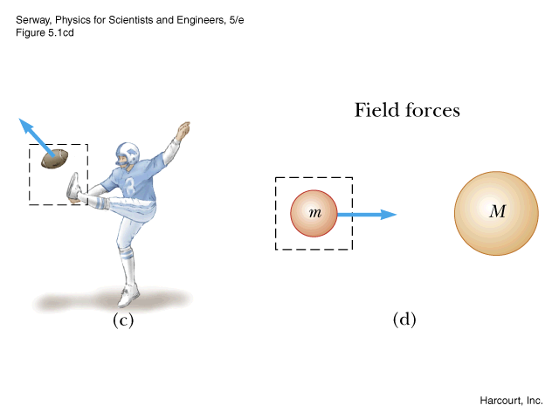
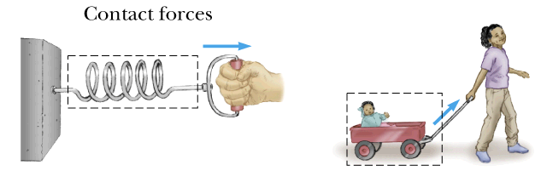
Contact Forces
Involve physical contact between objects.

Slide 4
Contact Forces
Pushing, pulling or twisting are the most common.
Adhesion – a force of attraction between different materials (e.g. Sellotape and paper, or the attraction between water and glass tubing - meniscus).
Cohesion – a force of attraction between particles of the same material (e.g. the attraction between water molecules that become rain droplets).
Surface Tension – a force of attraction between molecules across the surface of a liquid, which can be strong enough in water to support the weight of some insects.
Any force that occurs when two or more bodies actually touch.

Slide 5
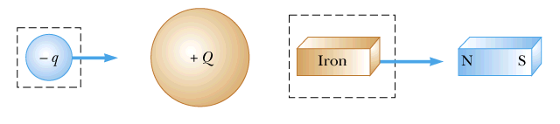
Non-Contact Forces:
No physical contact between objects.
Forces act through empty space.
gravity
magnetic
electric

Slide 6
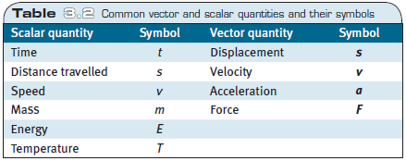
Force = mass x acceleration
Force is a vector quantity.
Recapping:
Mass in a scalar and acceleration is a vector. Since the equation F = ma has a vector quantity, then Force itself is a vector.

Slide 7
One Dimensional Force
The addition and subtraction of Force vectors are the same as the displacement and velocity vectors.
DRAW TO SCALE
Example 8.1 a: A toy car is applied a force of 3N to the East. The friction on the wheels is 1 N. What is the total force applied to the toy car.

Slide 8
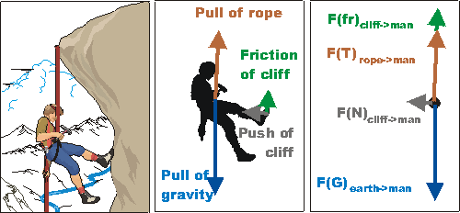
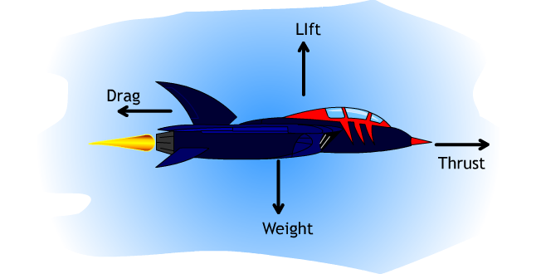
Drawing Forces on an object

Slide 9
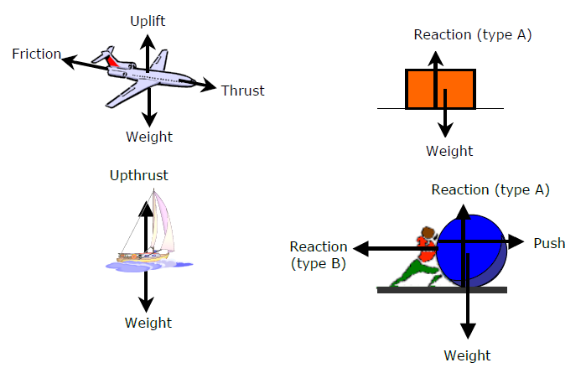
Types of Forces on an object

Slide 10
Types of Forces on an object
Force pairs

Slide 11
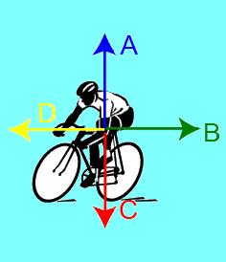
Types of Forces on an object
Example 8.1b
Label the forces
A –
B –
C –
D –

Slide 12
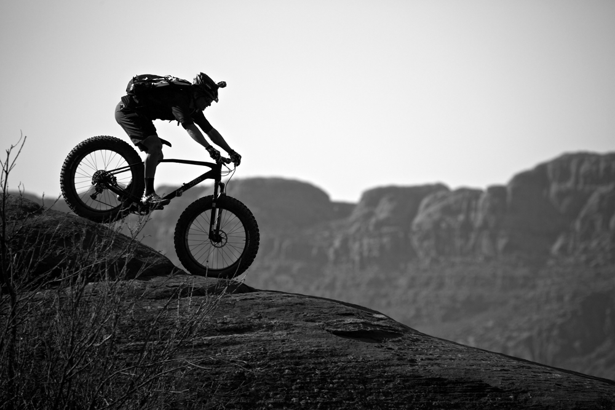
Types of Forces on an object
Example 8.1c: Draw and label the forces
θ

Slide 13
Homework, Context & Keywords
Homework
Complete all questions from Set 8.1 - due first lesson next week.
Read Chapter 8.2, page 247-249 and answer
Q1, 2 & 3 Set 8.2
by next lesson.

Slide 14
Gravitational Force
Chapter 8.2
Pages 247 - 249

Slide 15
Weight: F_{g} = m × a
Weight of an object is determined by the gravitational pull on the mass.
All masses have their own gravity; including you.

Slide 16
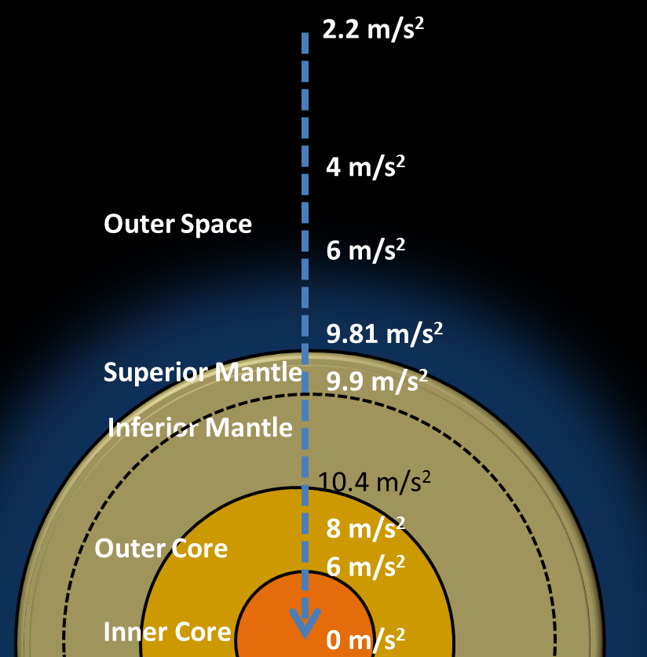
Acceleration on Earth

Slide 17
Acceleration on different planets
On Earth we assume the value for gravity is 9.8 m s⁻², regardless of location on the Earth’s crust.
If a person has a mass of 50 kg, then their weight is
What is their weight on the Moon, given the gravity is 1.622 m s⁻²?

Slide 18
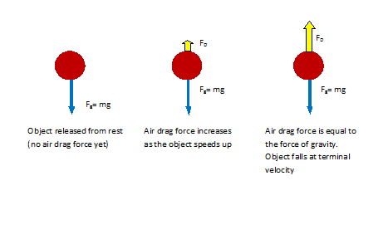
Terminal Velocity

Slide 19
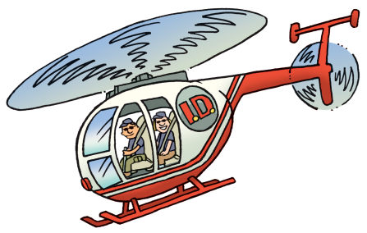
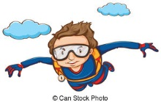
Terminal Velocity
Diagram 1
Diagram 2
Diagram 3
Diagram 4
Terminal Velocity is reached as the forces are no longer unbalanced.
F_{g} = 400 N
F_{g} = 1000 N
F_{g} = 800 N
F_{g} = 1000 N
F_{g} = 1000 N
F_{g} = 1000 N
F_{g} = 1000 N

Slide 20
Homework, Context & Keywords
Homework
Complete all questions from Set 8.2 - due first lesson next week.
Read Chapter 8.3, page 250-257 and answer
Q1 Set 8.3
by next lesson.

Slide 21
Newton’s Laws
Chapter 8.3
Pages 250 - 257

Slide 22
Newtons First Law of Motion
An object at rest will stay at rest, and an object in motion will stay in motion at constant velocity, unless acted upon by an unbalanced force.

Slide 23
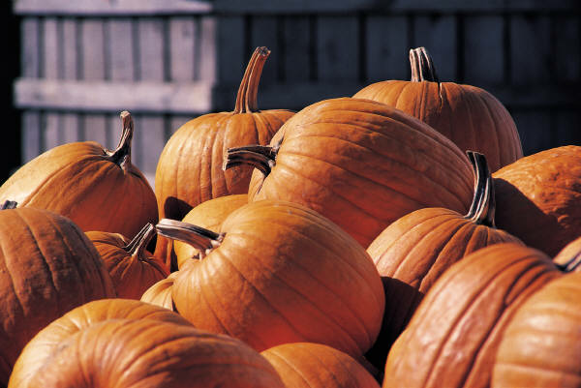
Newtons First Law of Motion
Inertia is the tendency of an object to resist changes in its velocity: whether in motion or motionless.
These pumpkins will not move unless acted on by an unbalanced force.

Slide 24
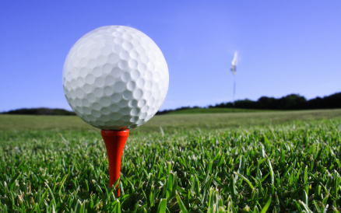
Newtons First Law of Motion
Unless acted upon by an unbalanced force, this golf ball would sit on the tee forever.

Slide 25
Newtons First Law of Motion
Why then, do we observe every day objects in motion slowing down and becoming motionless seemingly without an outside force?
It’s a force we sometimes cannot see – friction.
There are four main types of friction:
Sliding friction: ice skating.
Rolling friction: bowling.
Fluid friction (air or liquid): air or water resistance.
Static friction: initial friction when moving an object.

Slide 26
Newtons First Law of Motion
Don’t let this be you. Wear seat belts.
Because of inertia, objects (including you) resist changes in their motion. When the car going 80 km h⁻¹ is stopped by the brick wall, your body keeps moving at 80 km h⁻¹.

Slide 27
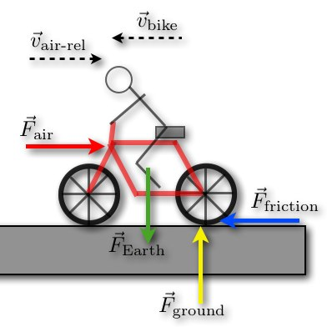
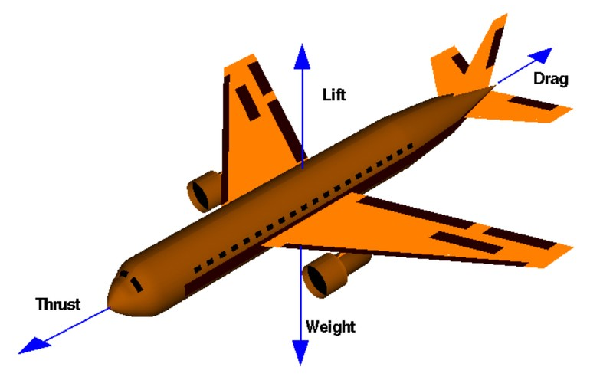
Newtons First Law of Motion
Drawing Vector Diagrams
Example 8.3 a: Draw a vector diagram for the following activities.
Riding a bike at a constant velocity
Abseiling down a cliff
Plane flying at constant velocity

Slide 28
Newtons Second Law of Motion
The acceleration of a body, a, is directly proportional to the net force acting on it, ΣF, and indirectly proportional to its mass, m:
ΣF=ma
Force is measured in Newton's (N)

Slide 29
Newtons Second Law of Motion
Newton’s 2nd Law proves that different masses accelerate to the earth at the same rate, but with different forces.
We know that objects with different masses accelerate to the ground at the same rate.
However, because of the Second Law we know that they don’t hit the ground with the same force.

Slide 30
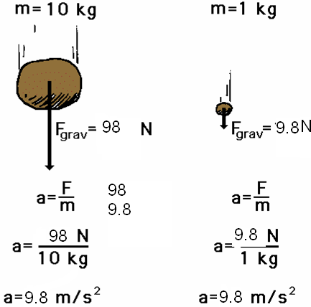
Newton’s Second Law proves that different masses accelerate to the earth at the same rate, but with different forces.
Newtons Second Law of Motion
We know that objects with different masses accelerate to the ground at the same rate.
However, because of the Second Law we know that they don’t hit the ground with the same force.
F = ma
F = 1 x 9.8
= 9.8 N
F = ma
F = 10 x 9.8
= 98 N

Slide 31
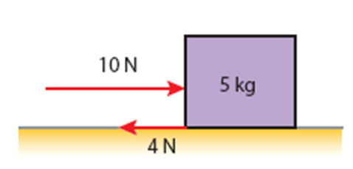
Newtons Second Law of Motion
Example 8.3 b:
A girl pushes a box of mass 5 kg along a frictionless surface with a steady horizontal force of 10N.
What is the acceleration of the box?
(b) If the box is pushed across a rough surface and the friction
encountered is
4 N, what will be
the acceleration
of the box?

Slide 32
Newtons Second Law of Motion
Example 8.3 c:
A medium sized Sedan with passengers and luggage has a mass of 1.15 x 10³ kg. It accelerates from rest to 60 km h⁻¹ in 8.5 seconds. Determine;
Its average acceleration
The average force applied

Slide 33
Newtons Second Law of Motion
The (inertial) MASS of an object is its ability to resist acceleration when the object is acted on by a net force.
Mass is a constant property of the object.
The WEIGHT of a body, W, is defined as the force of attraction on a body due to gravity:
W = mg
where m is the mass of the body
g is the acceleration due to gravity.

Slide 34
Newtons Second Law of Motion
Example 8.3 d: An astronaut on Mars feels a gravitational force of 715 N. If the astronauts weighs 1120 N on Earth, what is the gravity on Mars?

Slide 35
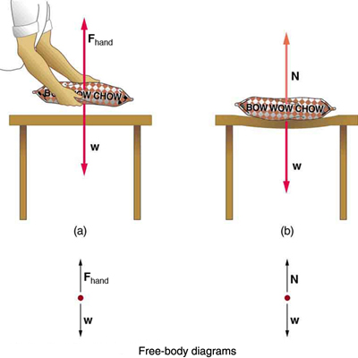
Newtons Second Law of Motion

Slide 36
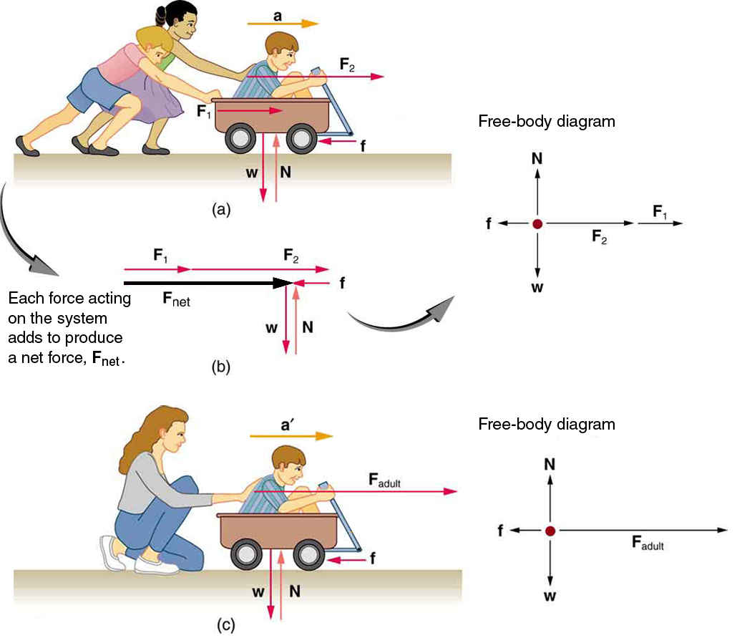
Newtons Second Law of Motion

Slide 37
Newtons Third Law of Motion
For every action force (object A on B), there is an equal and opposite reaction force (object B on A):
F (A on B) = –F (B on A)

Slide 38
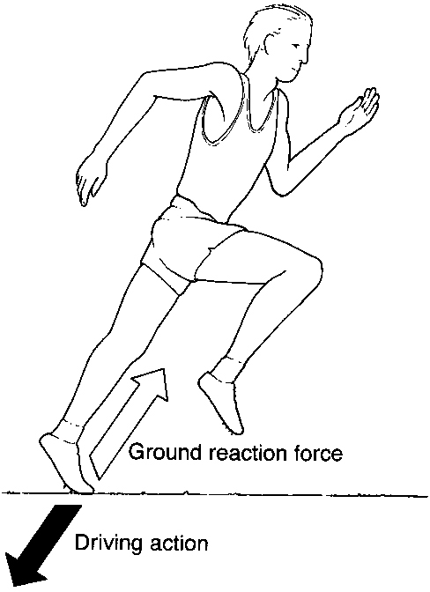
Newtons Third Law of Motion
Walking: your foot exerts a force on the ground (action force) and the reaction force (what the walker actually feels) is the ground exerting an equal force on your foot.
All motion can be explained in terms of
action and reaction force pairs.
Motion | Action Force | Reaction Force
Swimming | Hand pushes back on water. | Water pushes forward on hand.
Jumping | Legs push down on Earth. | Earth push up on legs.
Sky-diving | Force of gravity on the sky-diver from the Earth. | Force of gravity on the Earth from the sky-diver.

Slide 39
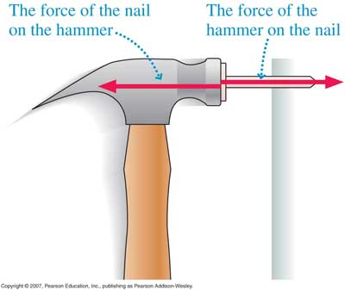
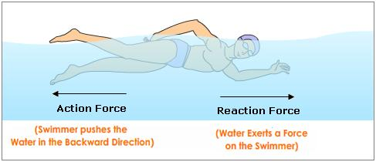
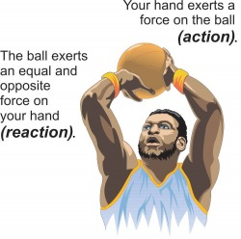
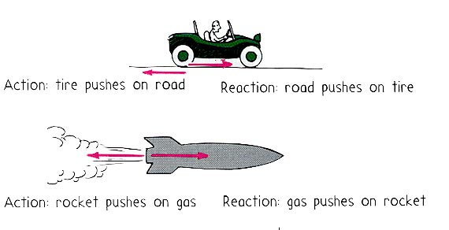
Newtons Third Law of Motion
Pictorially

Slide 40
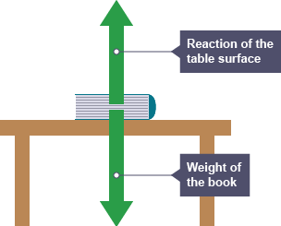
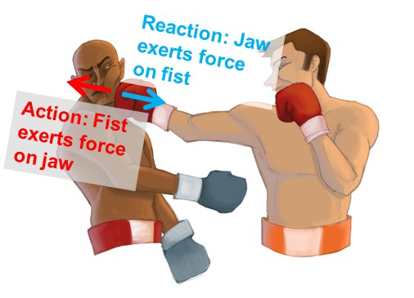
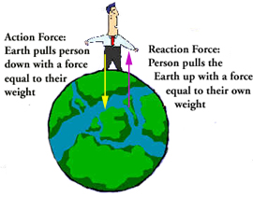
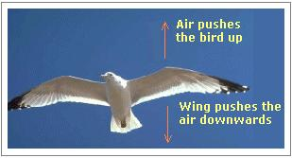
Newtons Third Law of Motion
Pictorially

Slide 41
Homework, Context & Keywords
Homework
Complete all questions from Set 8.3 - due first lesson next week.
Read Chapter 8.4, page 258-273 and answer
Q1 & 2 Set 8.4
by next lesson.

Slide 42
Two Dimensional Force Diagrams
Chapter 8.4
Pages 258 - 273

Slide 43
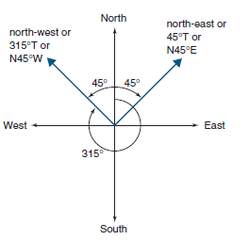
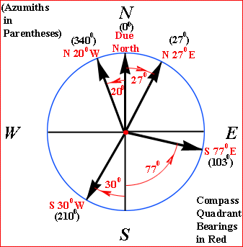
Bearing and Directions
and
Example 8.4 a: Identify the Bearing and
Direction of
the following.
Bearings
045ºT
315ºT
Directions
N45ºE
N45ºW

Slide 44
Net Force
Net Force is the vector sum of all forces acting on a object simultaneously.
ΣF = F₁ + F₂ + F₃ + ... + F_{n}
Force is a vector and therefore the direction is crucial in understanding the affects the combination of forces have on an object.

Slide 45
Two Dimensional Vectors
Graphical representation of vector forces must be to scale.
Draw all vectors to correct magnitude and direction.
Draw all vectors tail to head.
The resultant vector will run the shortest path from the origin tail to the head of the final vector.

Slide 46
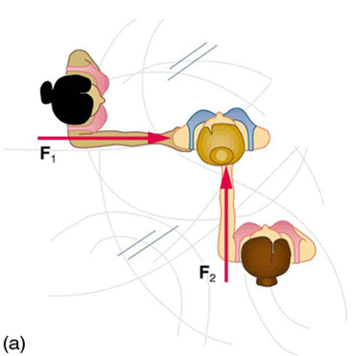
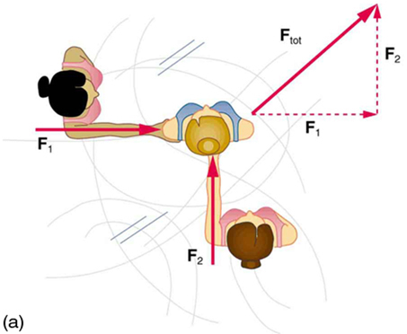
Two Dimensional Vectors
Example 8.4 b: Carol (blonde hair) is standing between Bonny (black hair) and Annette (brown hair). If Annette pushes Carol with a force of 15 N and the same time Bonny pushes Carol with a force of 25 N, then what force does Carol experience?

Slide 47
Multiplication of Vectors
Example 8.4 c:
Find 2A
Find -2A
Find ½B
Find 4B
A
B
16 N
10 N
30º
25º

Slide 48
Two Dimensional Vectors
Example 8.4 d:
For each question, draw the vector diagram.
Add A + B
Add C + D
A
B
55 N
C
D
40º
65 N
70 N
30 N
50º
60º
30º

Slide 49
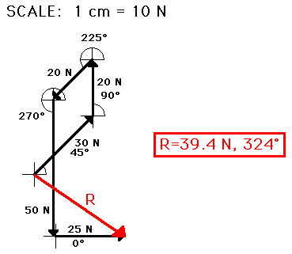
Two Dimensional Vectors
Having a large number of vectors to add together can make the whole addition of vectors very complex.
A simple method is to break each vector into its horizontal and vertical components (convert to x – axis and y – axis equivalent).
Then add all the x – axis
equivalent together and add
all the y – axis equivalent
together and use Pythagoras
to solve the resultant of two
components, rather than several.

Slide 50
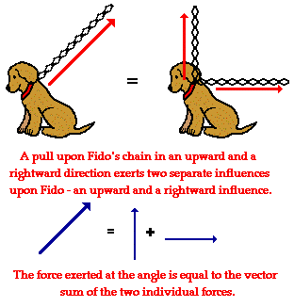
Two Dimensional Vectors
The horizontal and vertical components (x – axis and y – axis equivalent) are the same as the singular Resultant force.

Slide 51
Two Dimensional Vectors
Example 8.4 e:
What is the horizontal and vertical components for the following.
Add A + B + C + D
Add A + C
A
B
C
D
70 N
65 N
20º
30 N
55 N
50º
60º
45º

Slide 52
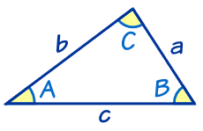
Cosine Rule
a² = b² + c² – 2 b c Cos(A)
Example 8.4 f:
Add the two vectors (A + B)
Subtract the two vectors (A – B)
A
B
16 N
10 N
30º
25º

Slide 53
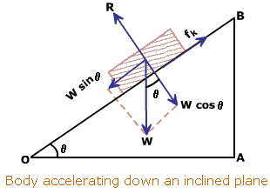
Inclined Planes
Inclined Plane
W sinθ
W
W cosθ
If W sin θ = f_{k}, then the object has constant velocity.
θ

Slide 54
Inclined Planes
Example 8.4 g: Car of mass 650 kg is parked on a hill of angle 40º from horizontal. What is the frictional force and normal action force.

Slide 55
Lift Systems
Example 8.4 h: Sally has a mass of 55 kg. She enters the express lift up to the 20th floor, before changing to the general lift to go down to the 17th floor.
a) What is her weight before entering the lifts.
b) If the lift is travelling with a constant velocity, what net force will Sally experience?
c) The lift accelerates from rest at 3 m s⁻² upwards. What force would she feel?
d) The lift accelerates from rest at 2 m s⁻² downwards. What force would she feel?

Slide 56
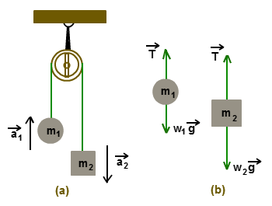
Pulley Systems
Tension has no direction, it is assumed to be in line with the direction of the object being stretched.
Example 8.4 i: If m₁ is 10 kg and m₂ is 15 kg.
a) Find the acceleration of this pulley system.
b) Find the tension
created by the 15 kg
mass.
c) What is the tension
on the rope in this
pulley system.

Slide 57
Homework, Context & Keywords
Homework
Complete all questions from Set 8.4 - due first lesson next week.
Read Chapter 9.1, page 280-282 and answer
Q1,2 & 3 Set 9.1
by next lesson.
Chapter 8 Review due first lesson next week.

